Slide 1
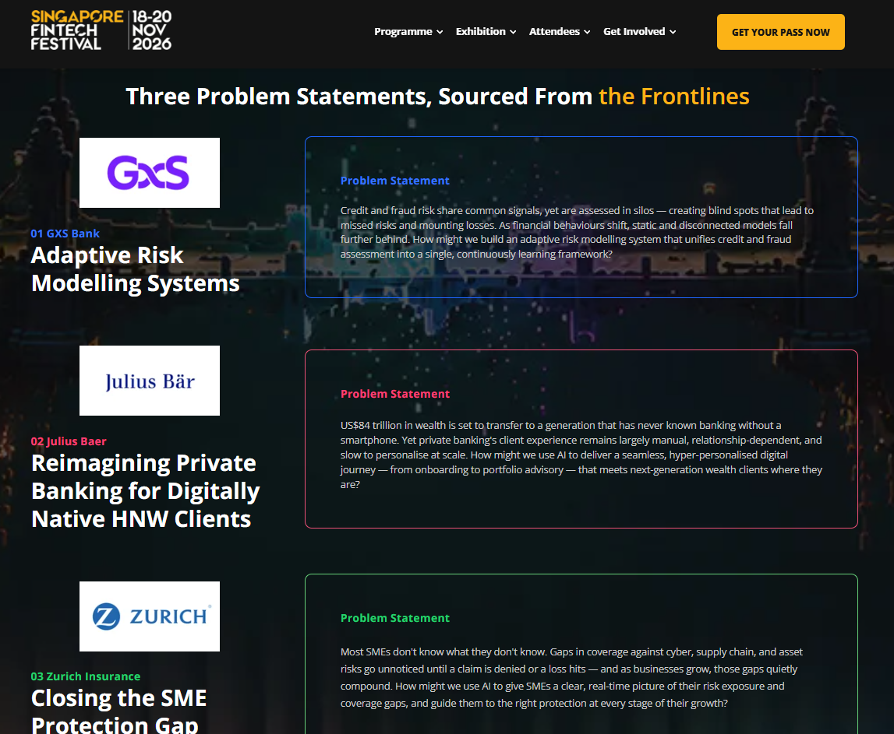

Slide 2
Problem Statement
US$84 trillion in wealth is set to transfer to a generation that has never known banking without a smartphone.
Yet private banking's client experience remains largely manual,
relationship-dependent, and slow to personalise at scale.
How might we use AI to deliver a seamless, hyper-personalised digital journey
— from onboarding to portfolio advisory
— that meets next-generation wealth clients where they are?

Slide 3
Solution – CAS Voice for Wealth Management
Secure real-time data, information and intelligence extraction from live conversations
without intrusion and obstruction to power automated banking procedures.
Silent Mobile Phone Carrier Handshake Authentication + SIM Swap (CAMARA)
Device Biometric Identification (WebAuthn)
Use an AML Data Provider to fetch legal name/address of verified phone number
Direct Line Connection between HNW Client and human Financial Adviser (CAS Voice Shared Lines)
Low-Latency Speech-to-Speech communication between HNW Client and virtual Financial Adviser (OpenAI gpt-realtime-2.1)

Slide 4
Demo - Smart Onboarding Engine
The demo Smart Onboarding Engine is a low-latency onboarding platform designed for private wealth management institutions. It collapses the traditional 14-to-30-day High-Net-Worth (HNW) client onboarding process into a single, 45-to-90-minute live session.
By replacing slow, disconnected compliance tasks with synchronous automation, the platform minimizes client drop-off risks, drastically improves conversion rates, and reduces administrative overhead.
The Innovation: The Tri-Partite Conversation Model
The platform introduces a collaborative, real-time onboarding workspace:
The AI Digital Financial Adviser: Leads the conversational discovery interview, naturally gathering net worth data and automatically populating KYC form fields via real-time speech analytics.
The HNW Client: Experiences a premium, zero-friction, voice-driven interaction on their mobile device without tedious multi-page form filling.
The Human Lead Adviser: Monitors a high-utility compliance dashboard passively, stepping into the audio stream to guide the client the exact moment a high-risk regulatory flag appears.

Slide 5
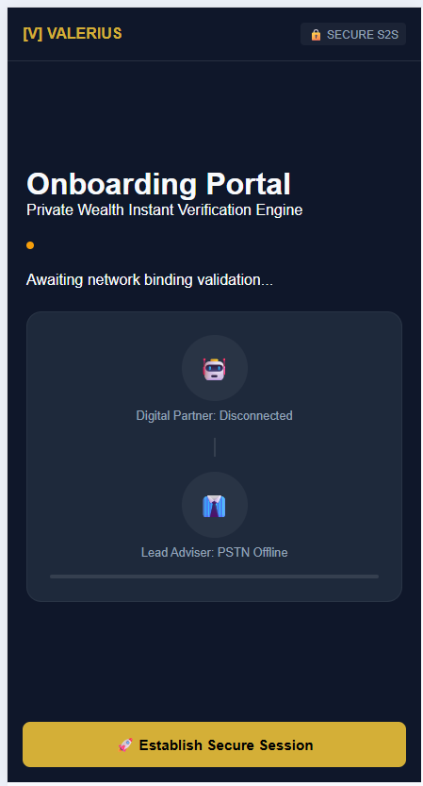

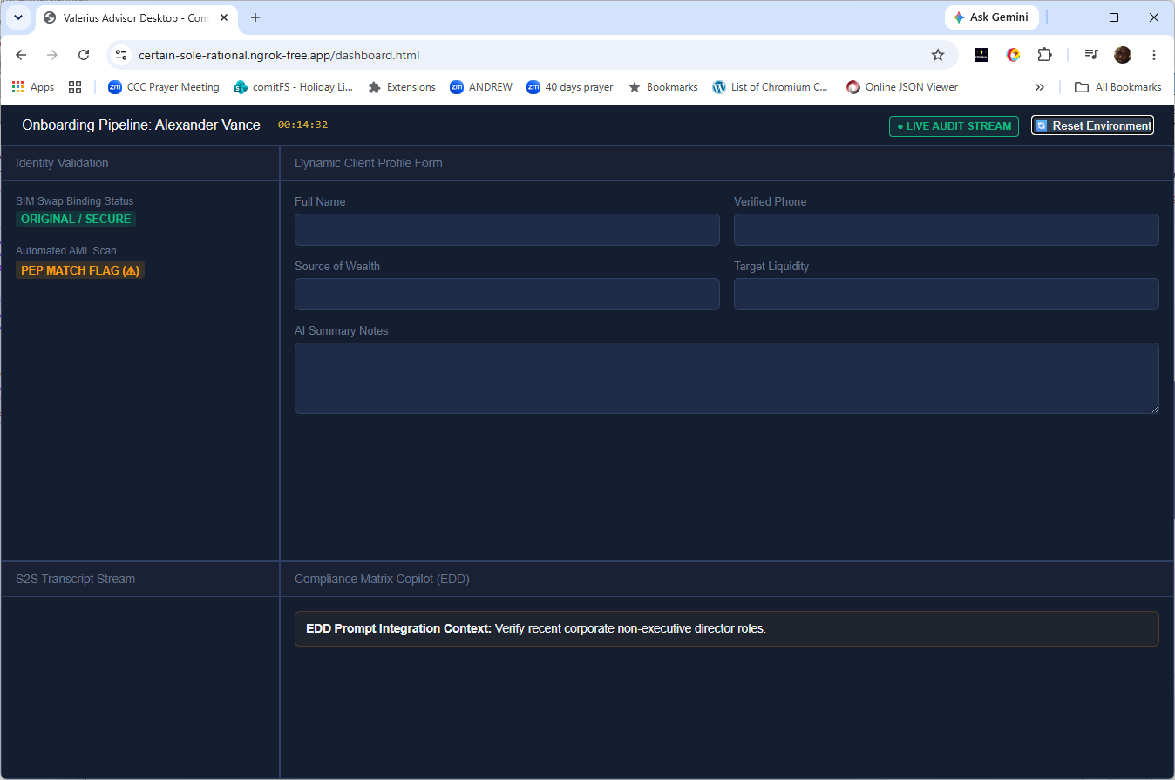
HNW Client on Smart-Phone
Mobile Identity Verification API 2.0 – Silent Carier Handshake
Digital Wealth Financial Adviser
Simultaneous very low latency Speech-to-Speech
(OpenAI gpt-realtime-2.1)
Financial Adviser Team (Dashboard + CAS Voice Aria)
Passive Listener ➔ Active Intervener Auto KYC form fields in JSON data
CAS Voice Shared Line

